Slide 1
Audience and User Analysis
By
Deepak Malpani (17BCE0306)
Udit Singhania (17BCE2060)

Slide 2
Abstract
Everyday millions of people posts their activities on social network sites like Facebook, Twitter, and Instagram etc. The users don’t know who all are actually viewing their posts in their friend list. The only confirmation they can get is from number of likes or comments their post’s received. The number of comment and likes shows number of people who actually reacted on your post but what about the people who viewed your posts but didn’t like or comment? That audience varies from day to day: friends may not log in to the site, may not see the content, or may not reply. Established media producers can estimate their audience through surveys, television ratings and web analytics, social network sites typically do not share audience information. This design decision has privacy benefits which preserve right to privacy but it also means that users may not accurately estimate their invisible audience when they post content. Social media users create a mental model of their imagined audience, then use that model to guide their activities on the site. In this project have analysed people perception on their audience count and how they misinterpret the actuality. The data was collected by estimating the actual audience size using server logs.
We found the type of people who are active on social networks by considering factors like age and gender, and how they impact on daily activities on Facebook.
We also collected the tweets on the topic “CoVID-19” For conducting the sentiment analysis of the public regarding this governmental policy, I have collected data in Twitter.

Slide 3
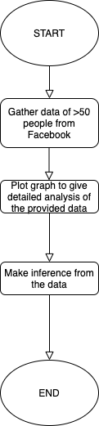
Overview of Proposed System
This project deals with the sentimental analysis along with other generalizations we attain in twitter. Twitter plays an important role in expressing our feelings about an event. The expression of anguish, as well as pleasure, can act as a measure of acceptance or rejection of certain ordinances. We will deal with classifying tweets according to the sentiments expressed in them which can be positive, negative or neutral.

Slide 4
Innovation component in our project
As analysing audience of small social network has been done already we will try to expand the analysis by analysing the overall Facebook audience which is similar to real life and give overall idea about its audience.
In twitter analysis what most of the researchers focus on sentimental analysis what we aim to do is to analyse the recent trends on twitter using the most trending topic in world which is CoVID-19.

Slide 5
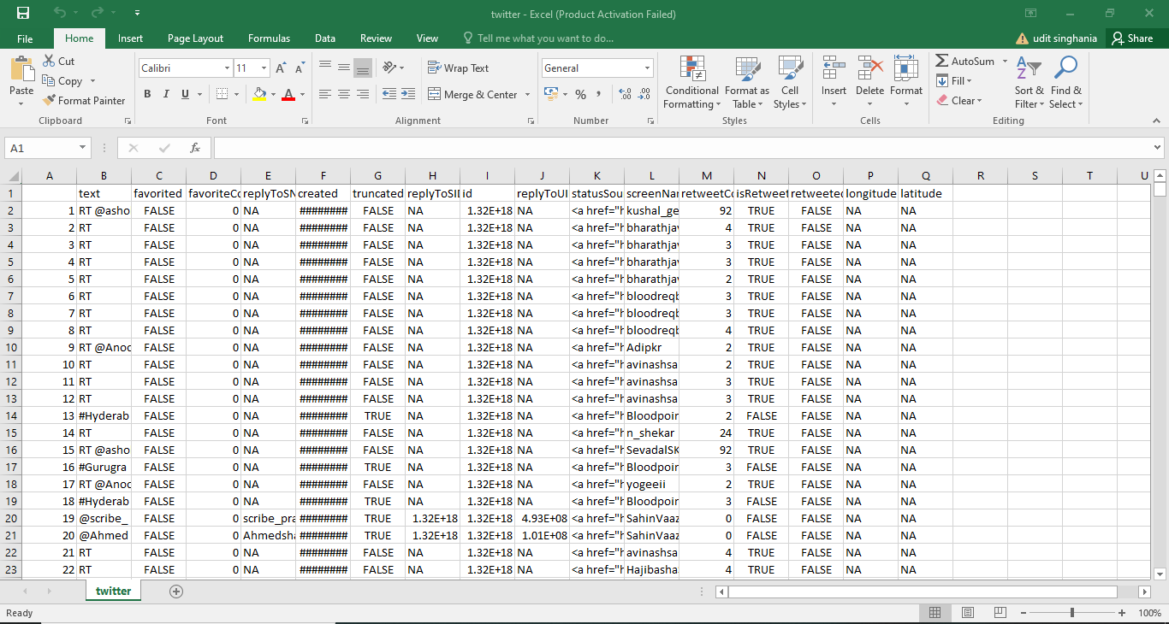
Scraped Twitter Data

Slide 6
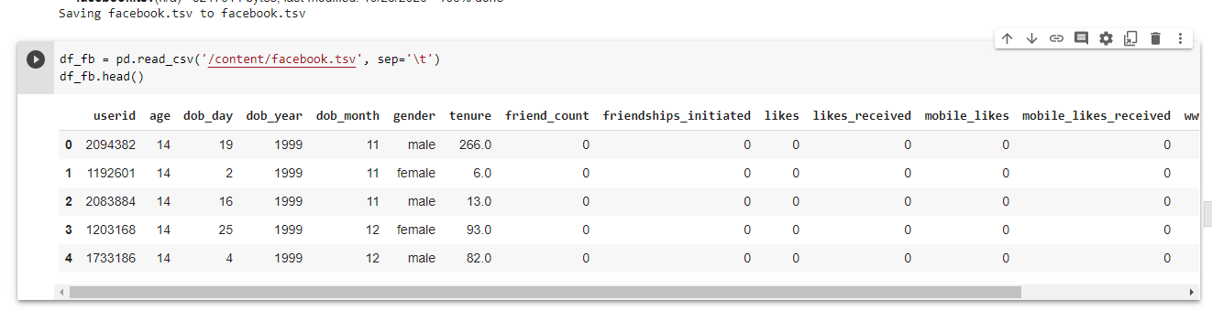
Scraped Facebook Data

Slide 7
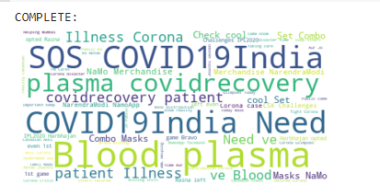
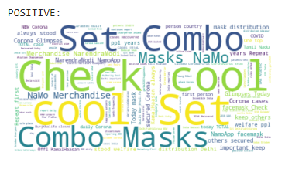
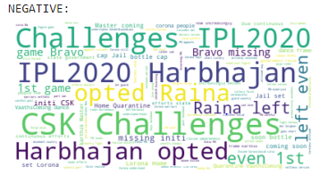
Twitter World Clouds

Slide 8
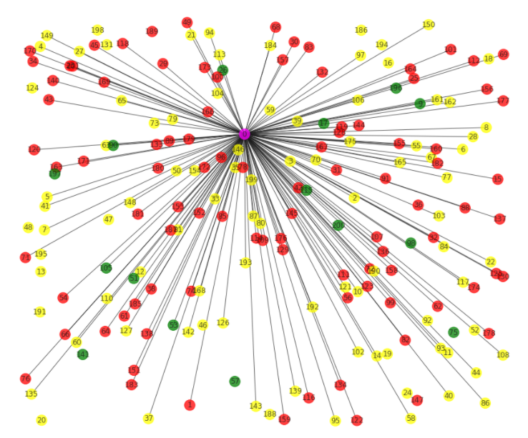
Sentiment vs No. of Retweets
Node color = Sentiment of user’s tweet, Edge Length = No. of Retweets) [Green = Positive, Red = Negative & Yellow = Positive]

Slide 9
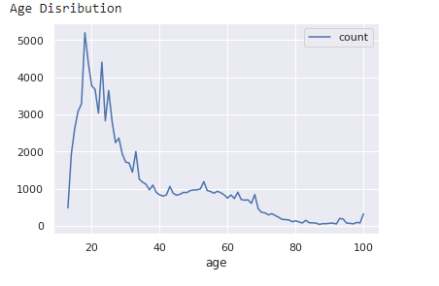
Facebook Age vs Users Distribution

Slide 10
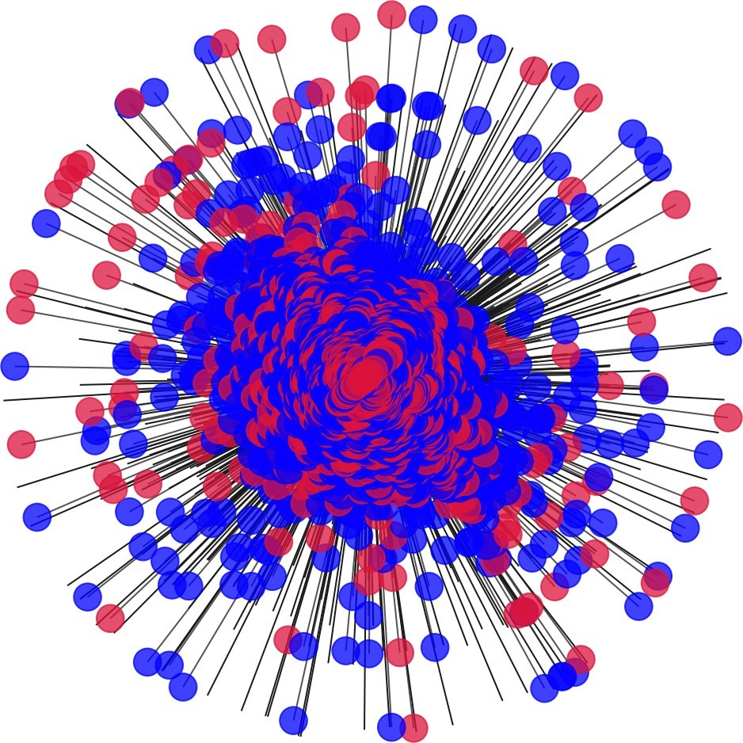
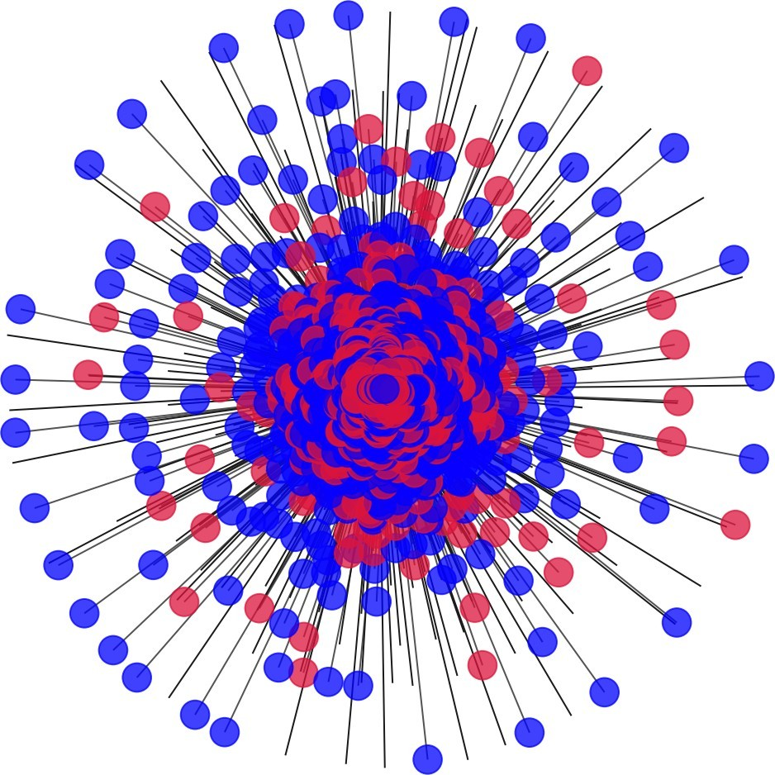
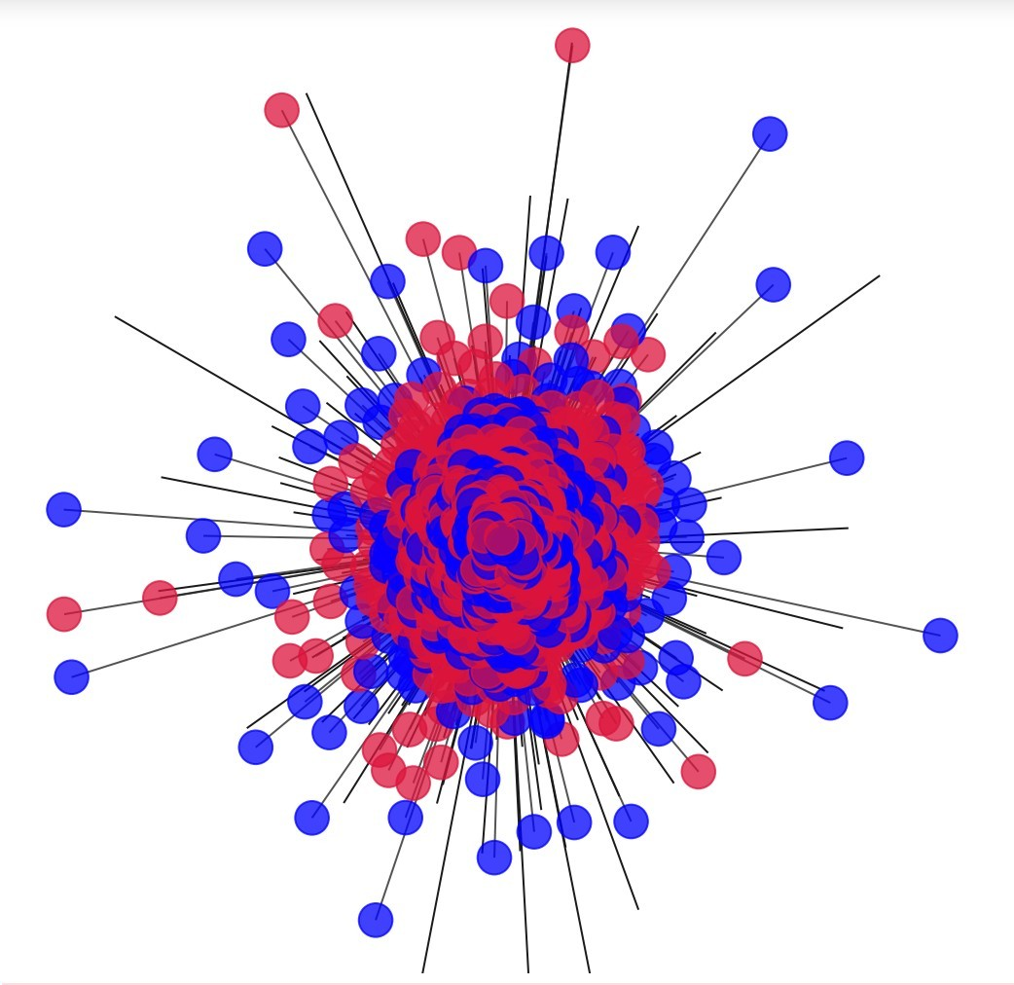
Age vs No. of Friends
Age=20
Age=40
Age=65
Red= Female, Blue= Male

Slide 11
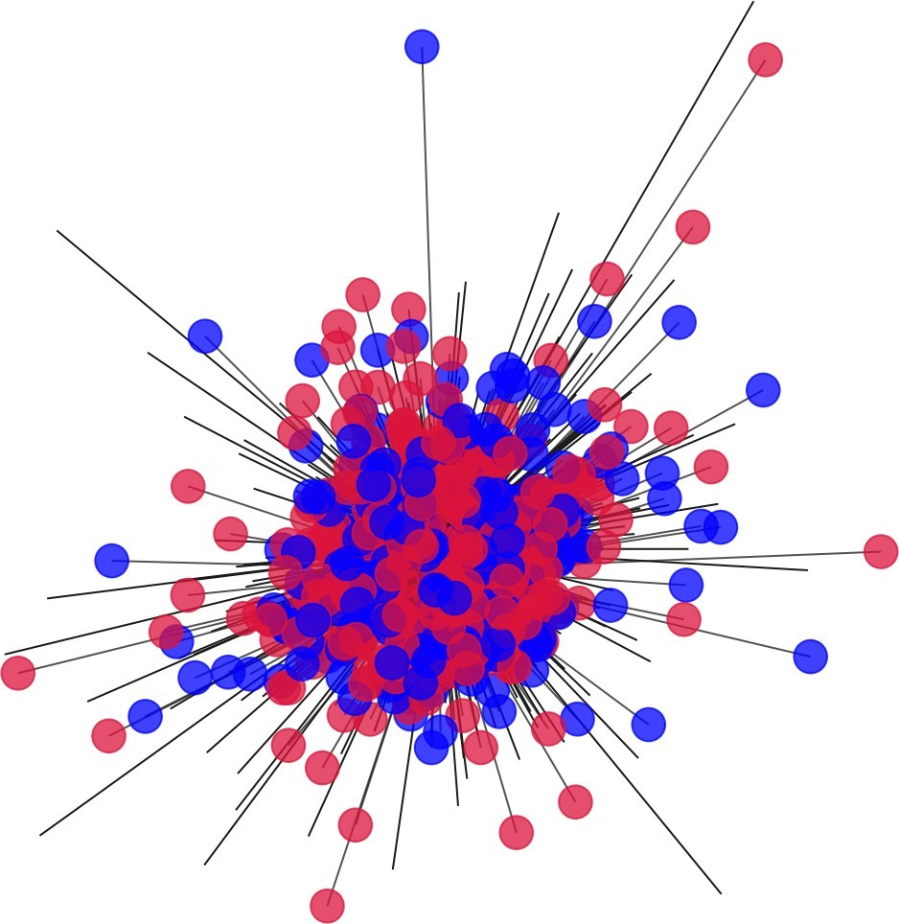
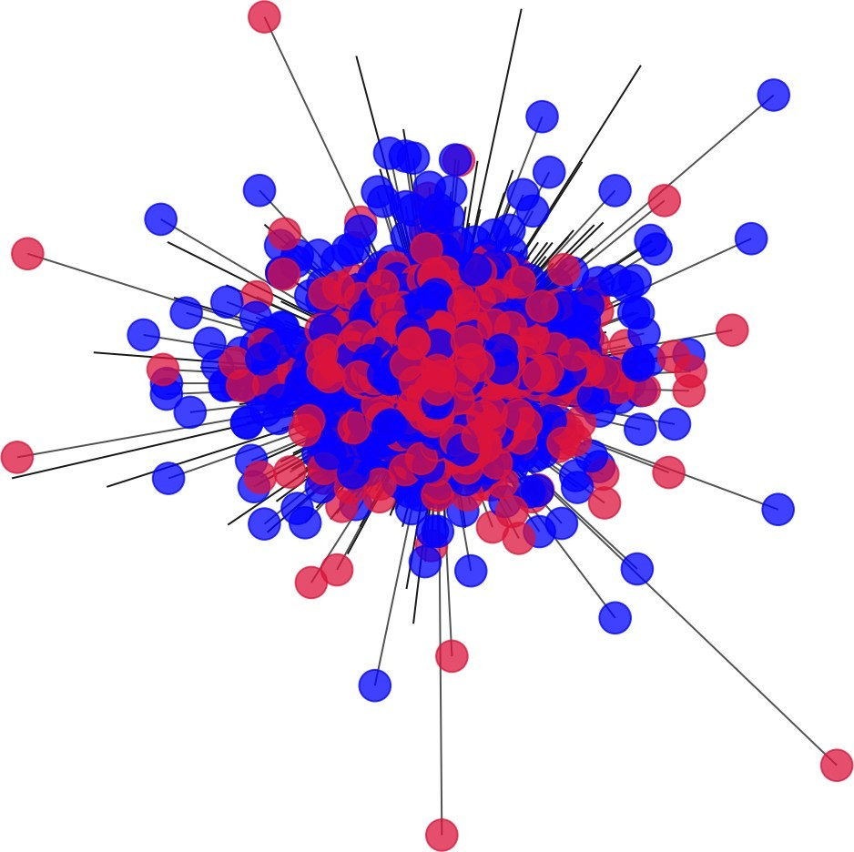
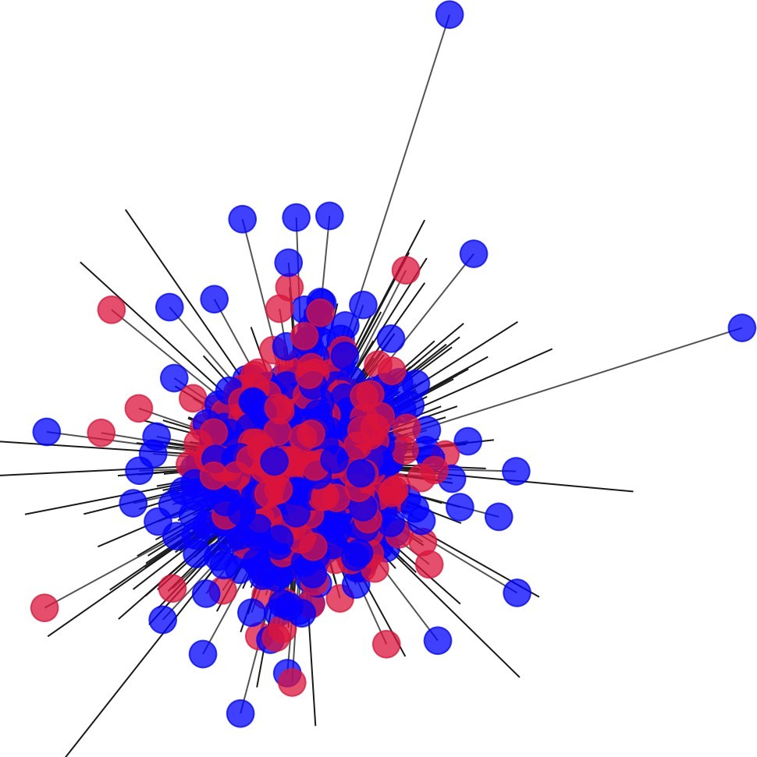
Age vs Tenure
Age=20
Age=40
Age=65
Red= Female, Blue= Male

Slide 12
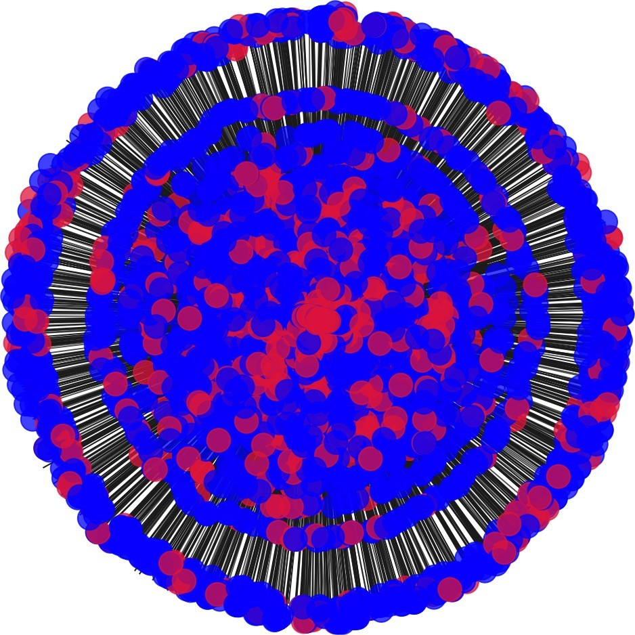
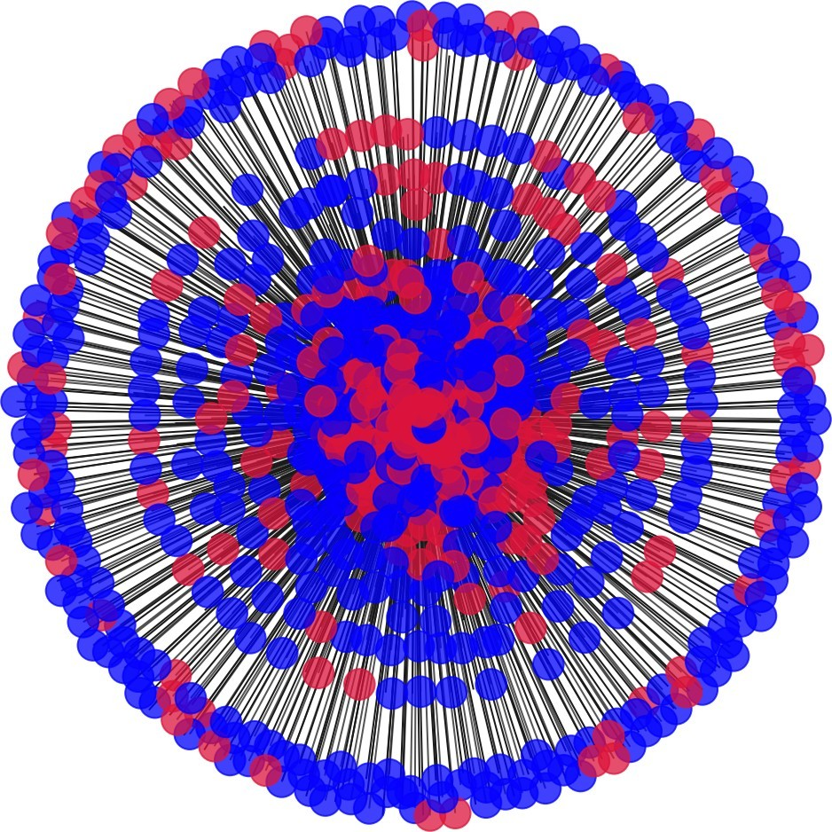
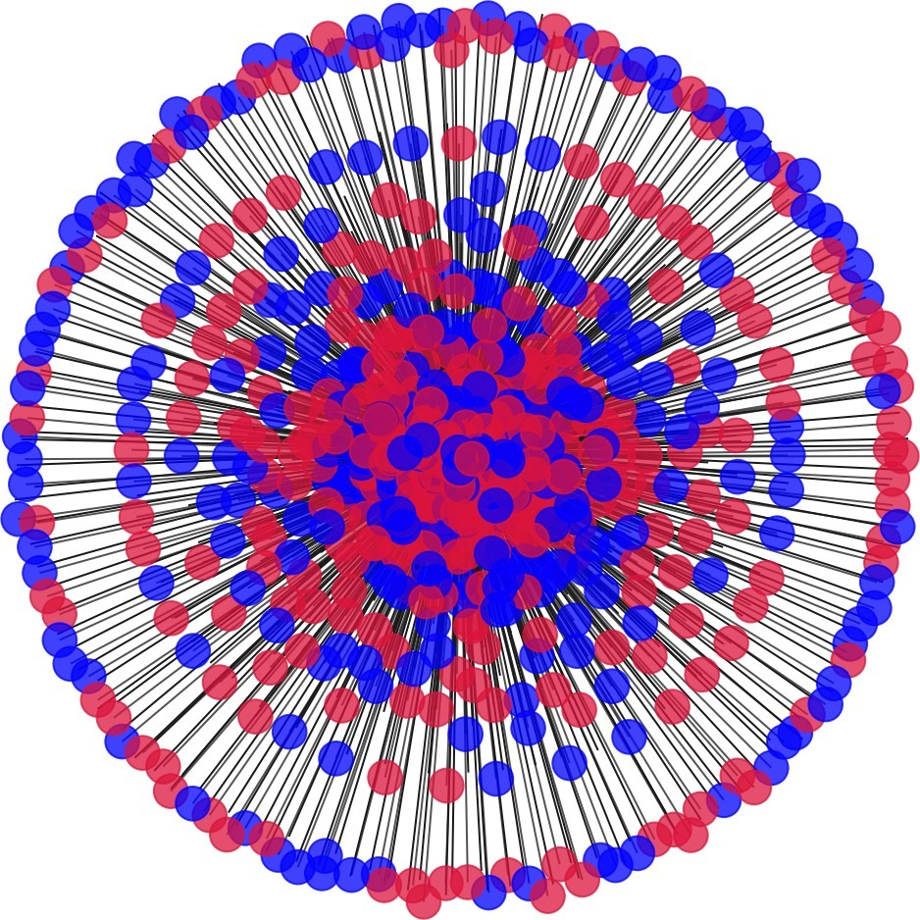
Age vs Likes Received
Age=20
Age=40
Age=65
Red= Female, Blue= Male

Slide 13
Conclusion
From the twitter data, we conclude that we can see that many of tweets regarding Covid-19 are focused on people asking for plasma donaters.
People promoted the positive sentiment more regarding than negative sentiments.
From the facebook data, we can see that the age group that is most active belongs to “adult”.
I see that people who have stayed longer on facebook have more friends.

